Slide 1
V2X

Slide 2
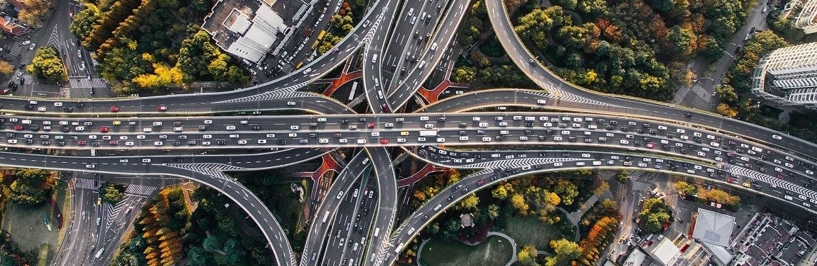
ITS
intelligent transportation system
effective and reliable traffic monitoring control
management to
avoid road accidents
improve traffic efficiency
V2X
2 - 30

Slide 3
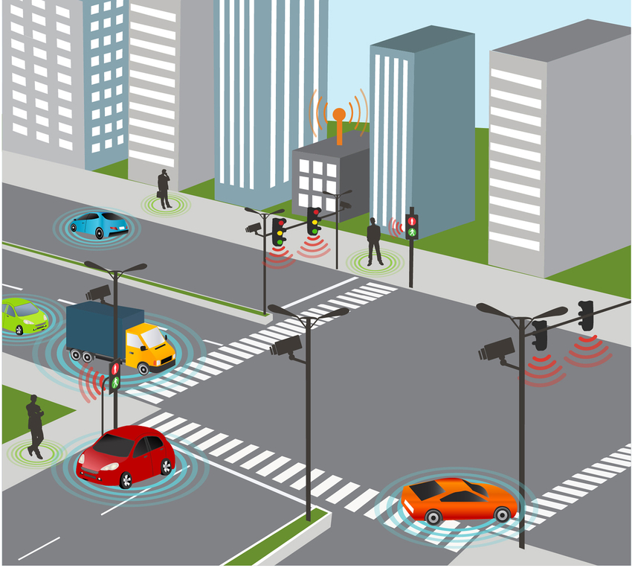
vehicle – to - everything
Vehicle-to-Network (V2N)
e.g. real-time traffic / routing, cloud services
V2X communications :
save lives,
reduce congestion,
lessen the negative
impact of transportation
on our environmen
Vehicle-to-Pedestrian(V2P)
e.g. safety alerts to pedestrians, bicyclists
Vehicle-to-Vehicle (V2V)
e.g. collision avoidance safety systems
Vehicle-to-Infrastructure(V2I)
e.g. traffic signal timing /priority
V2X
3 - 30

Slide 4
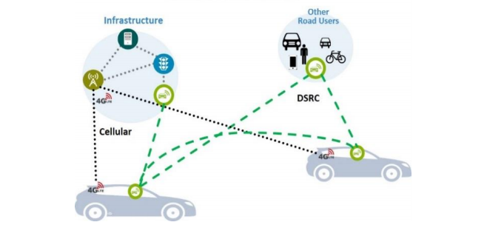
V2X communication
WLAN-based
Dedicated short-range communications (DSRC) technology
cellular-based
cellular vehicle-to-everything (C-V2X) communication
V2X
4 - 30

Slide 5
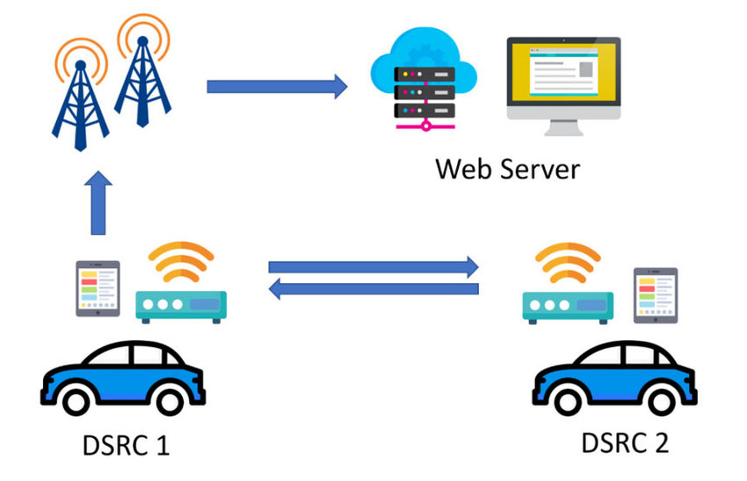
DSRC
IEEE 802.11p protocol
DSRC operates at 5.9 GHz
Maximum range: 1000 m
Vehicle speeds up to 100 mph
Low latency: 50 ms
V2I / V2V communication environments
provides very high data transfer rates and minimal latency
Data Rate – 6 to 27 Mbps
Channels – 7 Licensed Channels
V2X
5 - 30

Slide 6
DSRC Band
channel 172,174,176,178,180,182,184
Seven channels, 10 MHz each
5 MHz channel reserved for future use
172 is reserved exclusively for critical public safety communications
184 is reserved for high-power public safety use cases
The remaining channels can be used for non-safety applications.
5.875 GHz
5.925 GHz
CH 175
CH 181
CH 172 service
(safety only)
CH 174 safety & service
CH 176
safety & service
CH 178
Control
CH 180
safety & service
CH 182
safety & service
CH 184
Service
(high-power )
Reserved
5MHz
DSRC channel arrangement in the United States
V2X
6 - 30

Slide 7
V2X technological evolution (DSRC)
FCC allocated DSRC spectrum in the 5.9 GHz band to be used for ITS
Formation of Study group of IEEE802.11 Next Generation V2X
1990
2004
2018
2019
Formation of IEEE802.11p Task group
Formation of IEEE802.11bd Task group
V2X
7 - 30

Slide 8
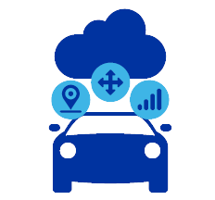
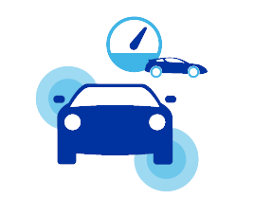
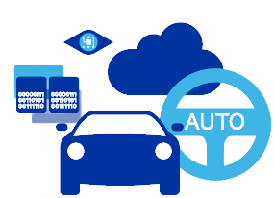
Paving the path to more autonomous driving
Requires continued V2X technology evolution
More
vehicle data
From sharing simple status data today to a fully coordinated driving experience
Increasing safety
requirements
Active safety use cases need to account for faster moving vehicles and denser traffic conditions
Expanding
use cases
New situational awareness, traffic management, and connected cloud services
V2X
8 - 30

Slide 9
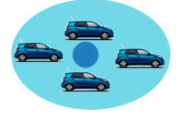
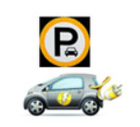


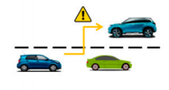
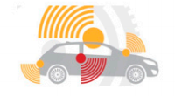


How C-V2X is Changing Driving
Collision avoidance
Platooning/Cooperative driving
Pedestrian safety
Connected Automated Parking
Hazards ahead warning
Queue warning
Emergency vehicle alert
Increasingly autonomous driving
V2X
9 - 30

Slide 10
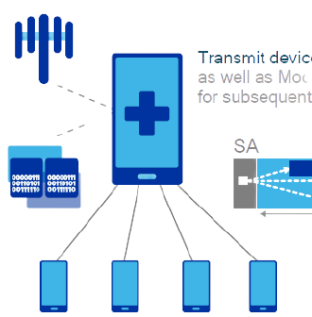
LTE Direct device-to-device communications
Introduced in Release 12 for public safety use cases
Centralized (Mode 1)
eNodeB allocates control and data resources to transmit devices
Distributed (Mode 2)
Transmit device selects RB from resource pools
V2X
10 - 30

Slide 11
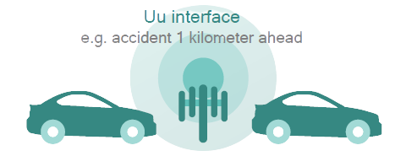
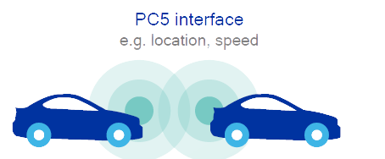
C-V2X employs two complementary transmission modes
Network communications (mod3)
Direct communications (mod4)
Network controlled (Centralized) scheduling
Autonomous (distributed) scheduling
Using LTE Broadcast to broadcast messages from a V2X server to vehicles and beyond. Vehicles can send messages to server via unicast.
More latency tolerant use cases, e.g. V2N situational awareness
Building upon LTE Direct device-to-device design with enhancements for high speeds, high density, improved synchronization and low latency
Latency-sensitive use cases, e.g. V2V safety
Operates both in-and out-of-coverage
V2X
11 - 30

Slide 12
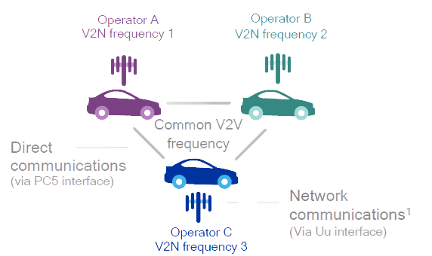
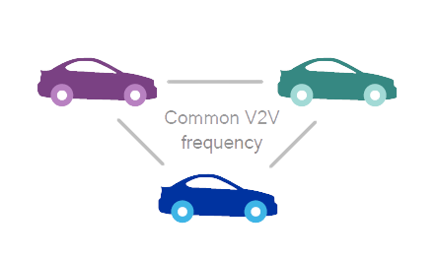
C-V2X designed for both in-coverage and out-of-coverage
Out-of-coverage
In-coverage
Direct communications
(via PC5 interface)
V2X
12 - 30

Slide 13
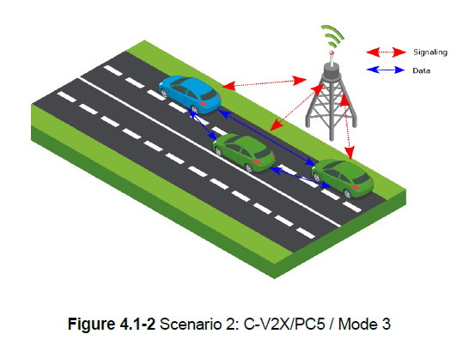
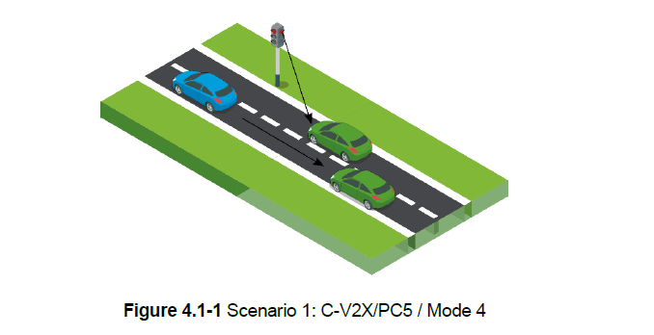
the two scenarios of V2X communications through PC5-based interface
vehicle UEs communicate independently from the network PC5 Mode 4 scheduling and interference management of traffic is supported based on distributed algorithms between vehicles
PC5 Mode 3 scheduling and interference management of V2V traffic is assisted via the base station (eNB) by control signalling over the Uu interface
V2X
13 - 30

Slide 14
The scheduling algorithms proposed(Mode 3)
exploit the proximity of nearby vehicles and organize vehicles into clusters (cluster-based)
vehicles individually and use the distance between vehicles to allocate radio resources using different heuristic algorithms (location-based)
V2X
14 - 30

Slide 15
autonomous resource selection algorithms(Mode 4)
random selection algorithm
energy sensing algorithm
geography-based (geo-based) selection algorithm
Fine geo knowledge selection algorithm
Coarse geo knowledge selection algorithm
V2X
15 - 20

Slide 16
Some of the key areas of enhancements were added to the D2D feature in order to support V2V communications:
Mode 1 from D2D was enhanced to mode 3 for V2X, similarly, mode 2 from D2D was enhanced to mode 4 for V2X.
Additional reference symbols to handle high Doppler associated with relative vehicle speeds up to 500km/h were introduced.
A new arrangement of scheduling assignments and resource allocation to allow reduced latency and better performance in high vehicle densities was developed.
Sensing with semi-persistent transmission based mechanism for the unmanaged or off coverage mode (mode 4) was incorporated, in order to sense congestion on resources and estimate future congestion on those resources.
- Enhancements were included to use GNSS for time synchronization in the off coverage scenario.
V2X
16 - 30

Slide 17
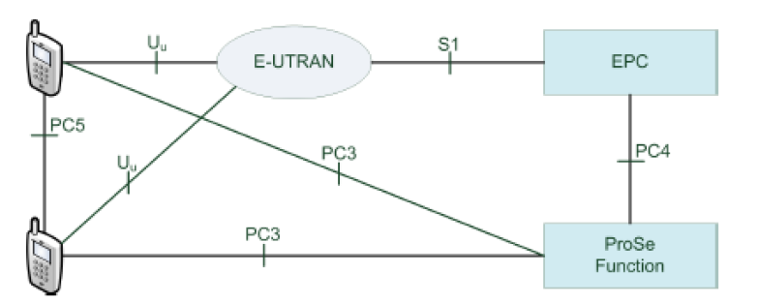
Interfaces and Entities in D2D in 5G
PC5-Direct Ue-to-UE Interface
PC3-Interface between UE and ProSe Server
PC4-Interface between ProSe server and EPC
Sl-Interface between EUTRAN and EPC
Uu-Interface between UE and EUTRAN
V2X
17 - 30

Slide 18
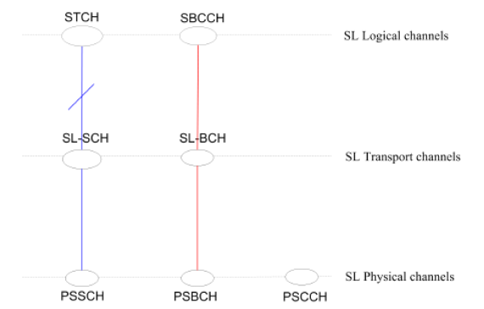
Dedicated different Layer for PC5 Communication
RLC Layer | STCH: Sidelink Traffic Channel(Data) | SBCCH: Sidelink Broadcast Control Channel(Control Channel for Direct Discovery in D2D)
MAC Layer | SLSCH: Sidelink Shared Channel(Data) | SLBCH: Sidelink Broadcast Channel(Control)
Physical Layer | PSCCH: Physical Sidelink Control Channel(Control Channel) | PSBCH: Physical Sidelink Broadcast Channel(Control Channel used in Direct Discovery in D2D) | PSSCH: Physical Sidelink Shared Control Channel(Data Channel)
(Red Control and Blue Data Channels)
V2X
18 - 30

Slide 19
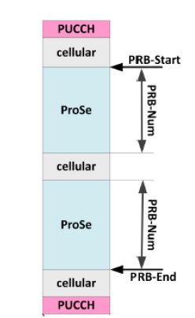
PRBs reserved as per Cellular and D2D traffic for PUCCH
Sidelink Chennel will be accommodating both Cellular Traffic as well as D2D communication Traffic with exclusively reserved PRBs in each and every channel.
we can see that some of PRBs (Physical Resource Blocks) are reserved for Cellular Traffic and some are reserved for D2D communication using PC5 Interface .
The PRBs reservation is necessary since the UE Device has to cater for both the kind of Traffic i.e Cellular as well as D2D Communication using PC5 Interface.
This is done to avoid the conflict between Cellular and D2D Networks.
V2X
19 - 30

Slide 20
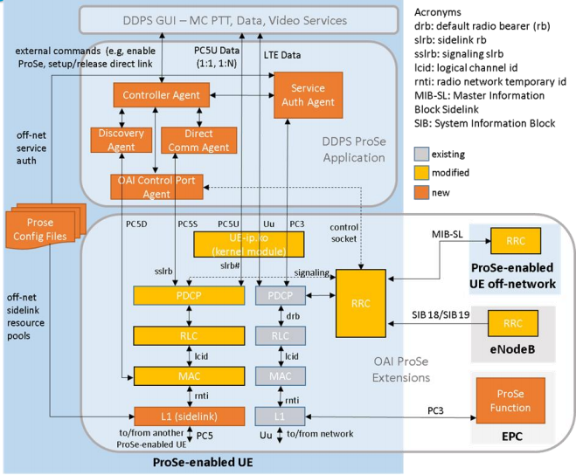
High-level Software Architecture
V2X
20 - 30

Slide 21
High-level Software Architecture
PC5-D: The discovery plane of PC5 interface is needed for direct discovery. Discovery allows a UE to discover other UEs that are in proximity. The ProSe Protocol interacts directly with the MAC layer
PC5-S: The PC5 signaling protocol stack is used for control plane signaling over the PC5 interface to establish, maintain, and release a secure direct link between two UEs.
PC5-U: The user plane PC5 interface is used to send traffic directly between two UEs.
PC3: The control plane PC3 interface is used for service authorization between the UE and the ProSe Function when the UE is connected to the network (i.e., on-network).
V2X
21 - 30

Slide 22
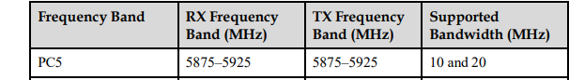
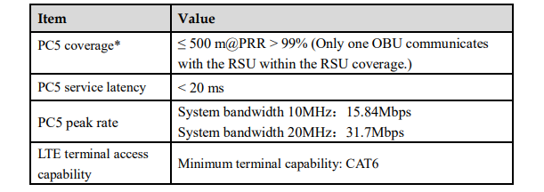
Pc5 - Interface
Frequency bands
Performance indicators
V2X
22 - 30

Slide 23
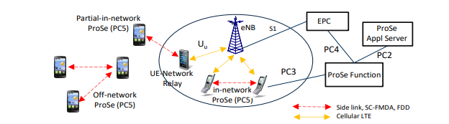
examples of use cases that combine PC5 and Uu connectivity
Video sharing between vehicles
Information sharing for automated driving
Cooperative lane change
Cooperative collision avoidance
Cooperative driving
Hazard warning
Forward collision warning
Intersection collision warning
Truck platooning
Distribution of security certificates
V2X
23 - 30

Slide 24
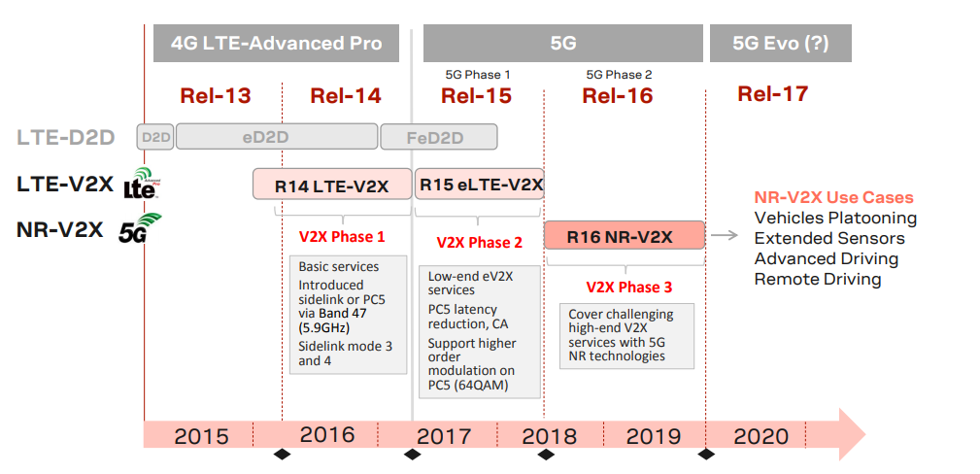
Evolve from LTE-V2X to NR-V2X
V2X
24 - 30

Slide 25
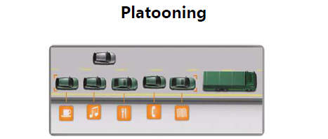
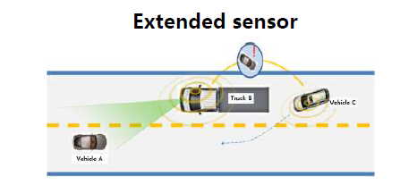
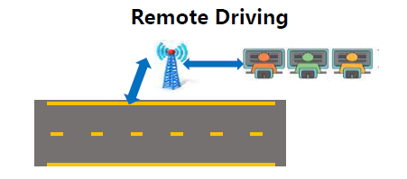
5G-V2X, high level and more complexity applications
5G Stage, vehicle networking evolution to cooperative, final to support Full Automatous
V2X
25 - 30

Slide 26
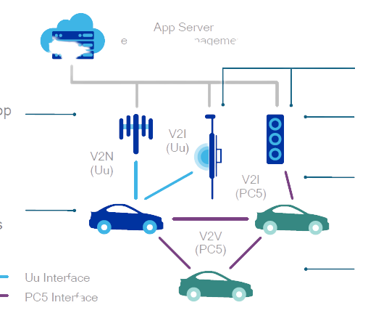

Delivering advanced services to vehicles
Opening up new opportunities and diverse business models for MNOs
App Server
e.g. traffic management
RSUs can be eNodeBs or standalone roadside devices
V2N provides over-the-top cloud services
RSUs can connect to network for cloud services
V2I
(Uu)
V2N
(Uu)
V2I allows RSUs to monitor traffic, e.g. traffic signals, tolls
V2I
(PC5)
Most use cases use a combination of interfaces
V2V
(PC5)
V2V mostly for safety
Uu Interface
PC5 Interface
V2X
26 - 30

Slide 27
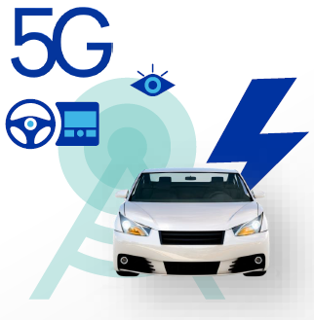
5G will bring new capabilities for the connected vehicle
New OFDM-based 5G air interface scalable to an extreme variation of requirements
Extreme throughput
1ms end-to-end latency
High availability
High reliability
V2X
27 - 30

Slide 28
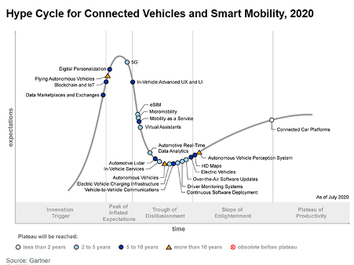
Hype Cycle
the large number of CAV technologies that are in the ‘Trough of Disillusionment’
This is where the hard work often begins to bring a technology to market.
V2X
28 - 30

Slide 29
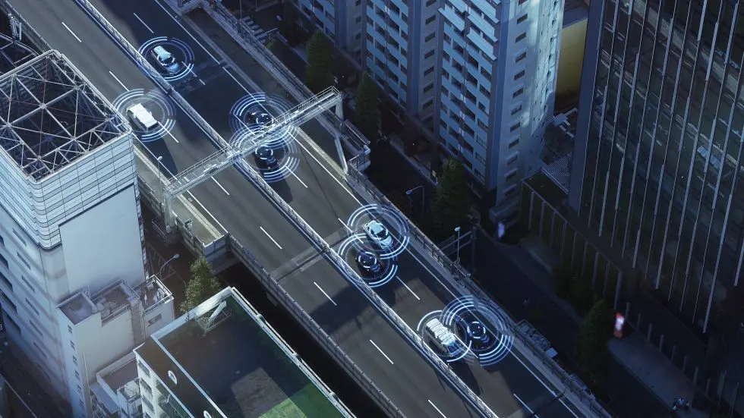
The Roadmap for Deployment
https://zenzic.io/
Australia – Improving Road Safety
China Leads the Way
The U.S. – Growing Momentum
Europe – Widespread Support
V2X
29 - 30

Slide 30
References
[1] Kenney, J.B., 2011. Dedicated short-range communications (DSRC) standards in the United States. Proceedings of the IEEE, 99(7), pp.1162-1182.
[2] Hu, J., Chen, S., Zhao, L., Li, Y., Fang, J., Li, B. and Shi, Y., 2017. Link level performance comparison between LTE V2X and DSRC. Journal of Communications and Information Networks, 2(2), pp.101-112.
[3] Sempere-García, D., Sepulcre, M. and Gozalvez, J., 2020. LTE-V2X Mode 3 scheduling based on adaptive spatial reuse of radio resources. Ad Hoc Networks, p.102351.
[4] Gu, X. and Ding, Y., 2018. A dynamic geo-based resource selection algorithm for LTE-V2V communications. EURASIP Journal on Wireless Communications and Networking, 2018(1), p.186.
[5] Molina-Masegosa, R., Gozalvez, J. and Sepulcre, M., 2018, December. Configuration of the c-v2x mode 4 sidelink pc5 interface for vehicular communication. In 2018 14th International Conference on Mobile Ad-Hoc and Sensor Networks (MSN) (pp. 43-48). IEEE.
[6] Dinan E, Kyungmin Park, 2018. Everything-to-Vehicle and Control Traffic Communications(V2X). Ofinno Technologies 2018 January
[7] EURECOM, 2018. Integration of Sidelink Procedures in OAI (ProSe Applications)
[9] Zhang, X., Shang, Y., Li, X. and Fang, J., 2016, September. Research on overlay D2D resource scheduling algorithms for V2V broadcast service. In 2016 IEEE 84th Vehicular Technology Conference (VTC-Fall) (pp. 1-5). IEEE.
V2X
30 - 30

Slide 31
Thank you
https://www.linkedin.com/in/simakarami/
Mail: simakarami1996@gmail.com
https://github.com/SimaKaramii

